Slide 1

Where and How
Findings and implications
Proposal
Analysis
Magic Towns of Mexico
¿How “touristy” is a Magic Town?
Integrantes:
Ana Kelyna Siliceo
Margarita Garza
Cristina Carmona
Marcelo Garcia

Slide 2
Your presentation must:
Be at least 8-10 min. long
Describe the core message or hypothesis for your project.
Describe the questions you and your group found interesting, and what motivated you to answer them
Summarize where and how you found the data you used to answer these questions
Describe the data exploration and cleanup process (accompanied by your Jupyter Notebook)
Describe the analysis process (accompanied by your Jupyter Notebook)
Summarize your conclusions. This should include a numerical summary (i.e., what data did your analysis yield), as well as visualizations of that summary (plots of the final analysis data)
Discuss the implications of your findings. This is where you get to have an open-ended discussion about what your findings "mean".
Tell a good story! Storytelling through data analysis is no different than in literature. Find your narrative and use your analysis and visualization skills to highlight conflict and resolution in your data.

Slide 3
1.- Decompose the ask
Proposal
Find the main characteristics for Magic towns in Mexico that make them attractive for tourism, like accessibility, accommodation and interest points.
Questions to answer:
Which towns are more worth visiting?
Which towns are more accessible to non local tourists?
Which towns are closest to the biggest mexican cities?
Which towns offer good quality accommodation?
Which towns offer enough interest points that make visiting worthwhile?
Magic Towns designation has been one of the most important initiatives to promote tourism in Mexico, since tourism is the 3rd source of income for the country. Since the beginning of health measures for COVID19, tourism has been one of the most affected activities

Slide 4
Where and How
2.- Identify data sources
Data | Source
Magic Towns in Mexico (List of names) | https://www.gob.mx/sectur/articulos/pueblos-magicos-206528
Nearby Commercial Airports (List of nearby Airports) | Places API https://console.cloud.google.com/
Accommodation (Hotels number, Hotels rating) Place of interest (Number of Tourist attractions) | Hoteles.com API by RapidAPI https://hotels4.p.rapidapi.com/
Distance to major cities | Distance Matrix Api https://console.cloud.google.com

Slide 5
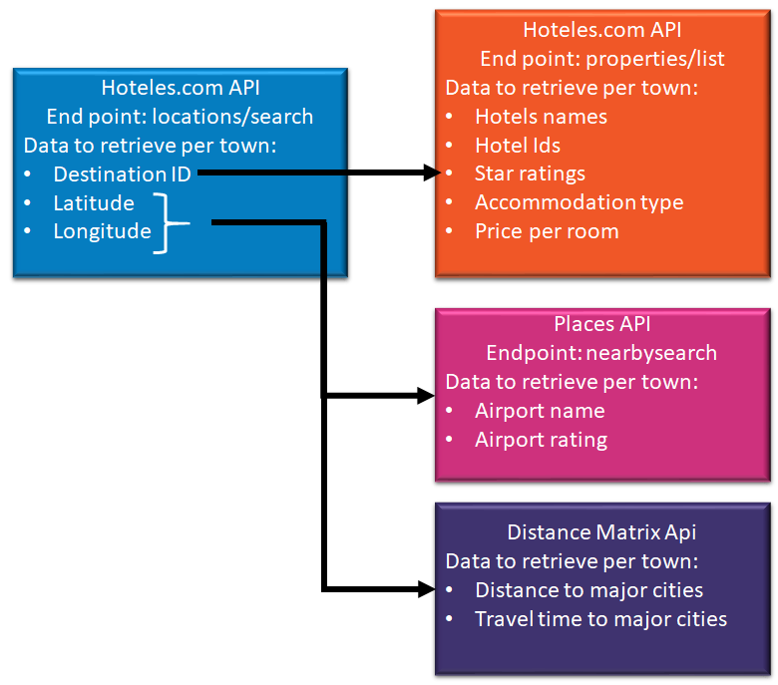
Where and How
3.- Defying strategy and metrics
Metrics:
Number of hotels
Amount of landmarks per town
Accommodations types
Airport accessibility
Distance to major cities (Monterrey, Mexico City and Guadalajara)
Accommodation average price
The data retrievable plan was:
4.- Build data retrievable plan
5.- Retrieve data

Slide 6
Where and How
6.- Assemble and clean
Data | Cleaning
Magic Towns names | For names of more than two words like Real de Asientos, we had to see how the API recognized the city. For example, in this case, we changed the city name to just Asientos in order to get results from the Hotels API.
Accommodation types | Cleaning of similar categories. For example, there was "Cabin" and "Cabins" as different categories, and we unified both as Cabin.
Nearby airports | Filter Magic towns without airports nearby
Price per room | Filter accommodations without price. Eliminate exchange rate MXN from the information to change from string to number. The API gives the information as MXN 1,600, and this has to be changed to 1,600.
Hotels | Filter Magic towns without hotels information
Distances to major cities | The response from the API gives the distance as 295 KM (string value), so it has to be changed to 295 (numeric value).

Slide 7
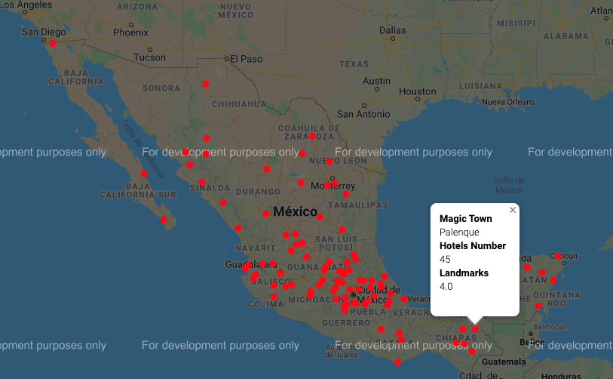
Where are the Magic Towns in Mexico?
Analysis
7.- Analyze for trends
Analysis
8.- Make the call or Tell the story

Slide 8
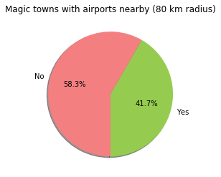
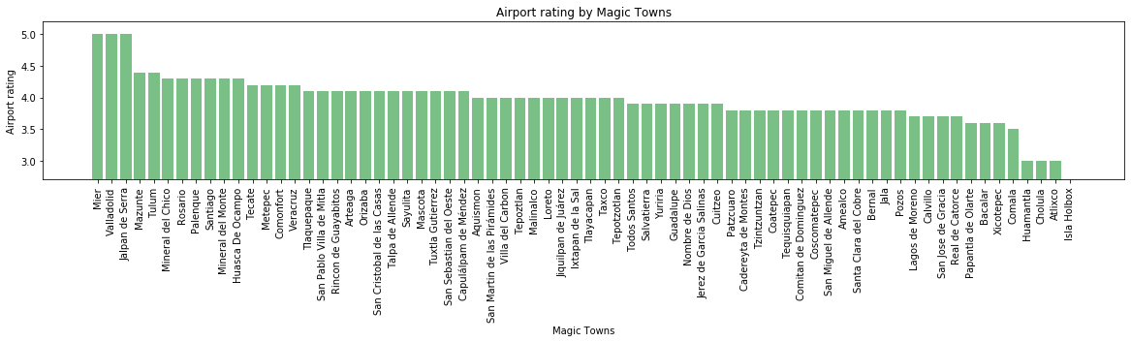
Which towns are more accessible to non local tourists?
Analysis

Slide 9
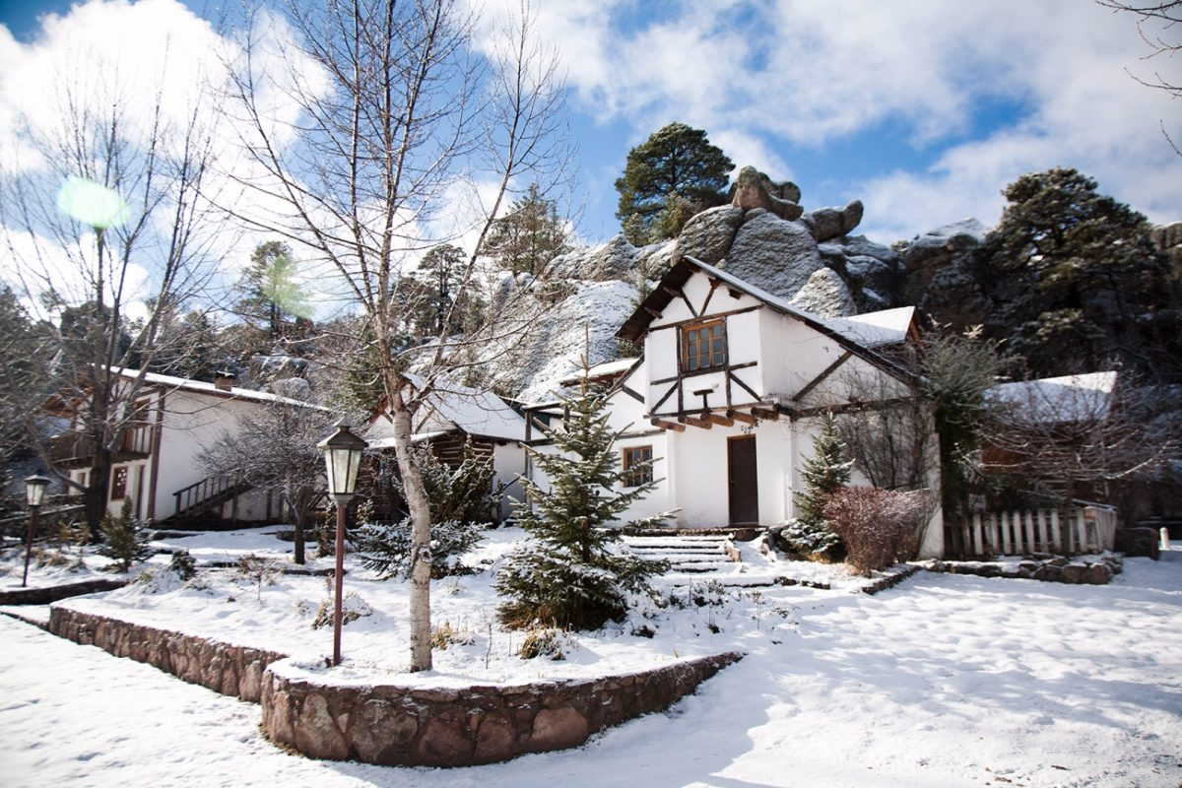
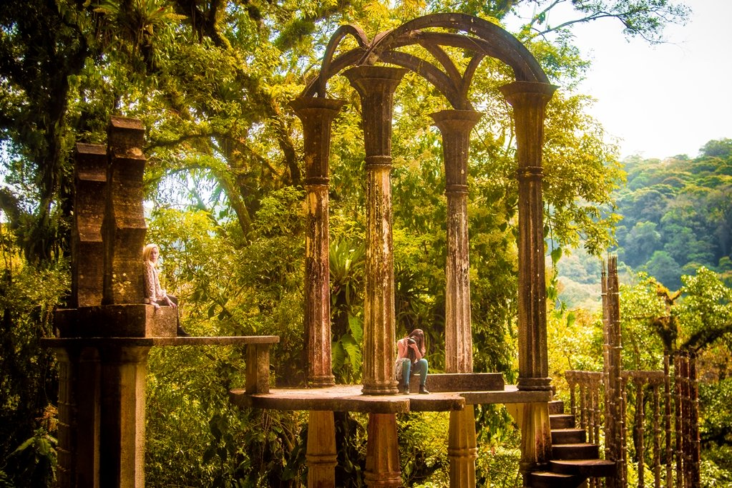
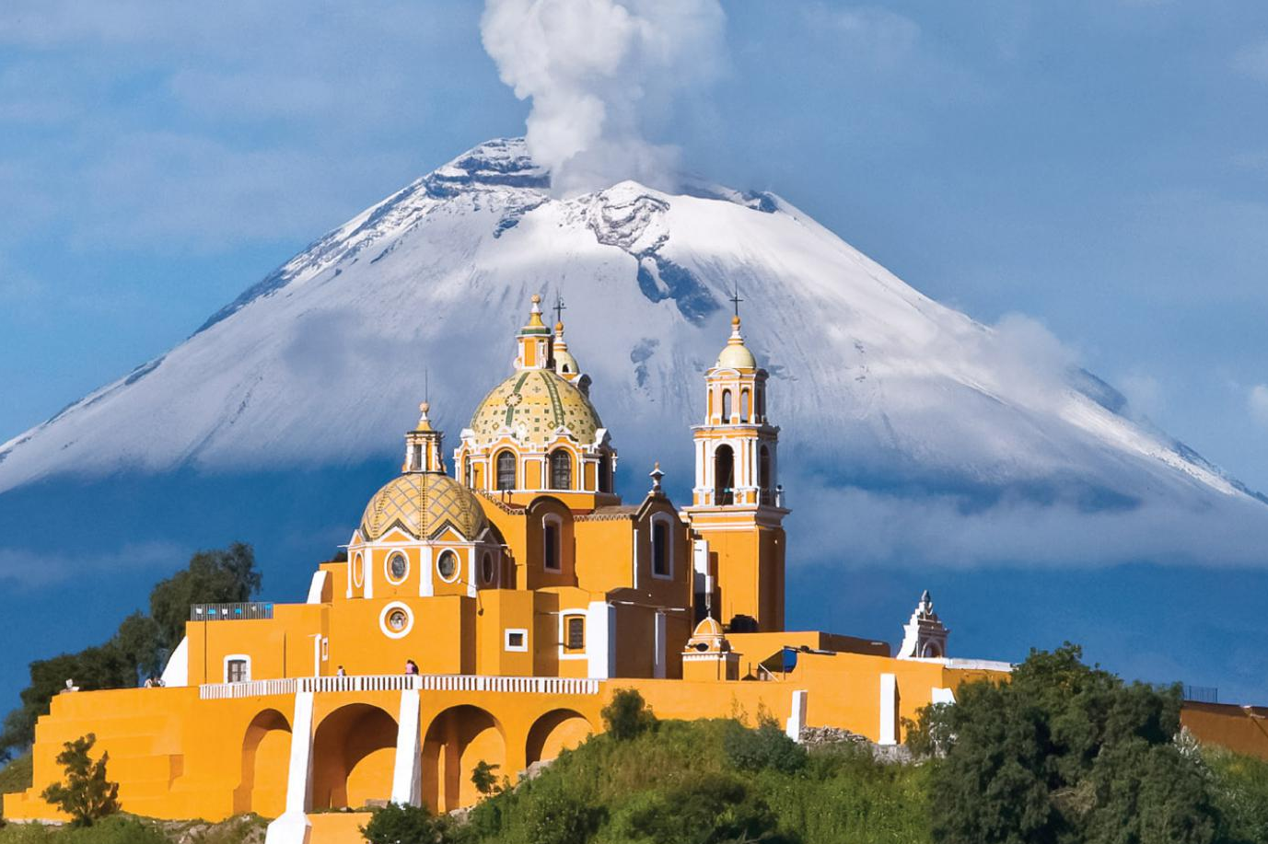
Which towns offer good quality accommodation?
Analysis
To answer this question we figured it was important to assess the availability, quantity and quality of hotels.

Slide 10
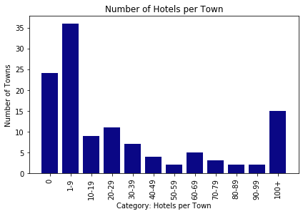
Which towns offer good quality accommodation?
Accommodation Availability
Analysis

Slide 11
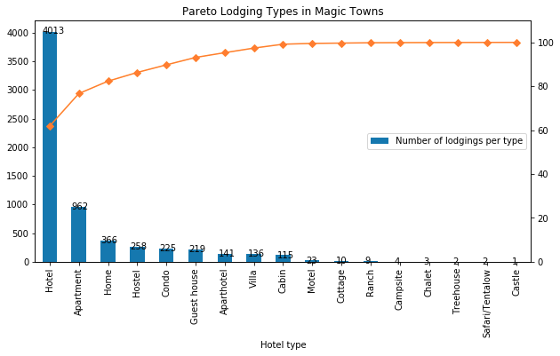
Which towns offer good quality accommodation?
Accommodation Types
Analysis

Slide 12
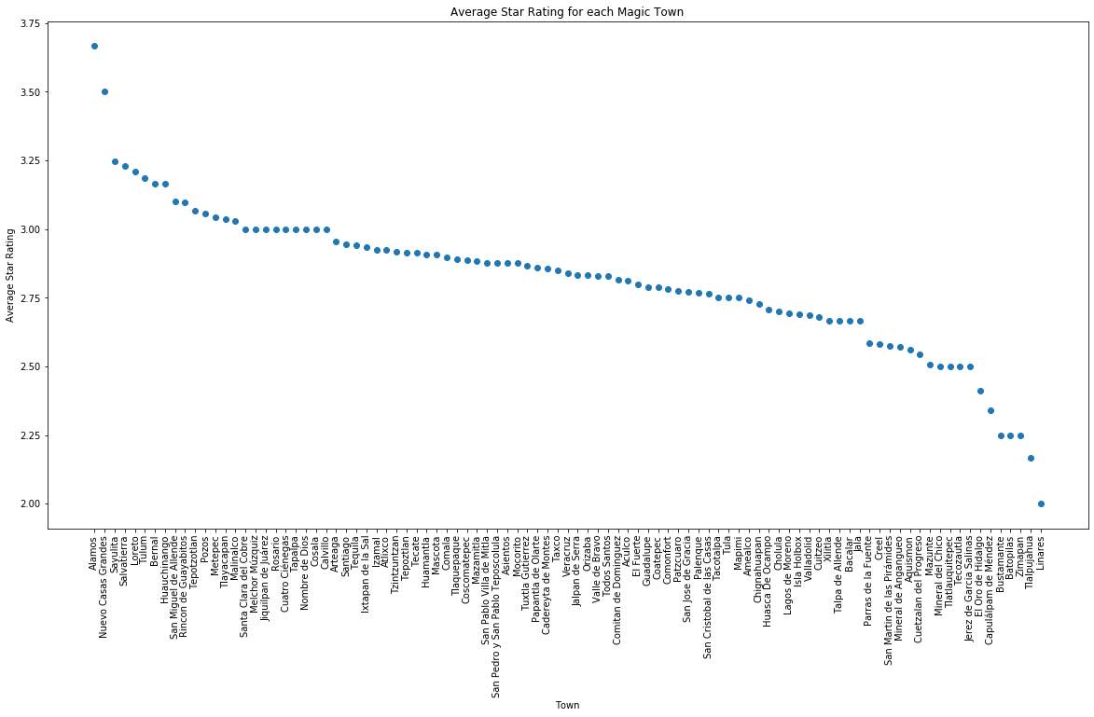
Which towns offer good quality accommodation?
Accommodation Quality
Analysis

Slide 13
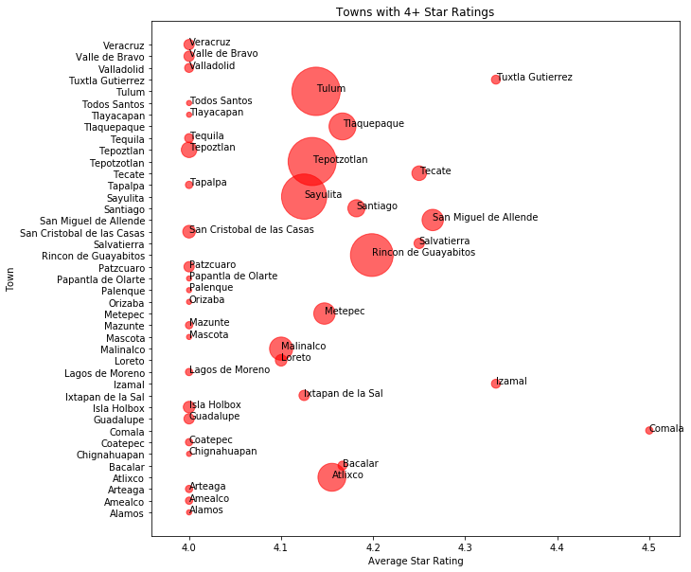
Which towns offer good quality accommodation?
Premium Accommodation Availability
Analysis

Slide 14
Which towns offer good quality accommodation?
Accommodation Prices Summary
Analysis
 |  | Min | Max | Mean
0 | and below | $119.00 | $23,738.00 | $1,085.19
1 | - | $173.00 | $14,000.00 | $1,051.03
2 | - | $417.00 | $71,581.00 | $3,012.96
3 | and more | $842.00 | $12,040.00 | $5,998.46

Slide 15
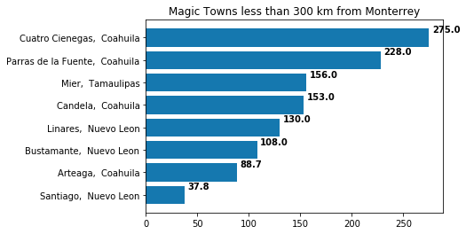
How many magic towns are close to major cities?
Analysis

Slide 16
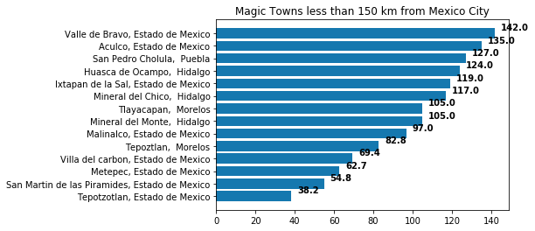
How many magic towns are close to major cities?
Analysis

Slide 17
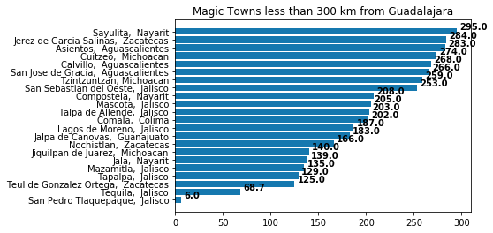
How many magic towns are close to major cities?
Analysis

Slide 18
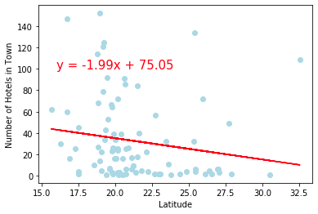
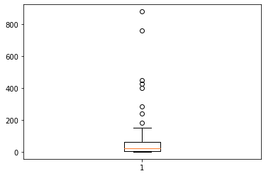
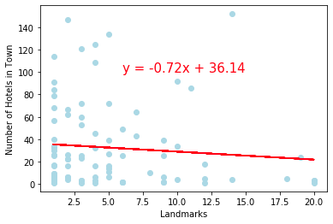
Number of hotels in town and other variables
Analysis
Outliers: Malinalco, Tlaquepaque, Atlixco, Tepotzotlán, Tulum, Sayulita, San Miguel de Allende and Rincón de Guayabitos

Slide 19
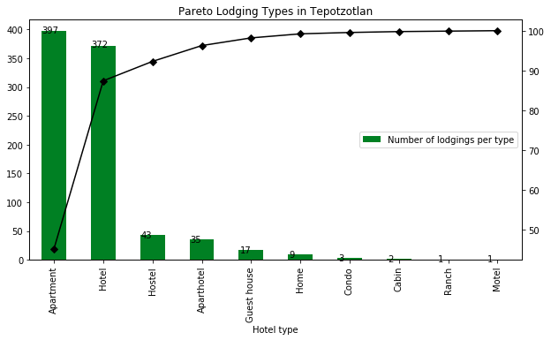
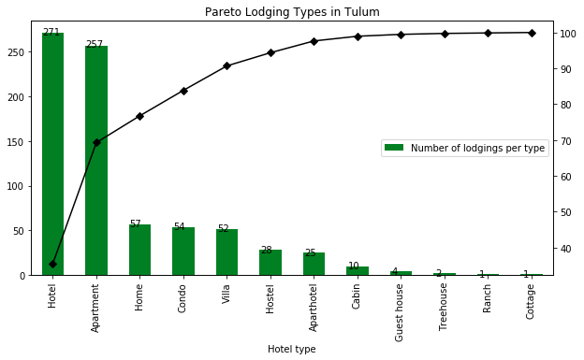
Hosting options in major outliers
Analysis

Slide 20
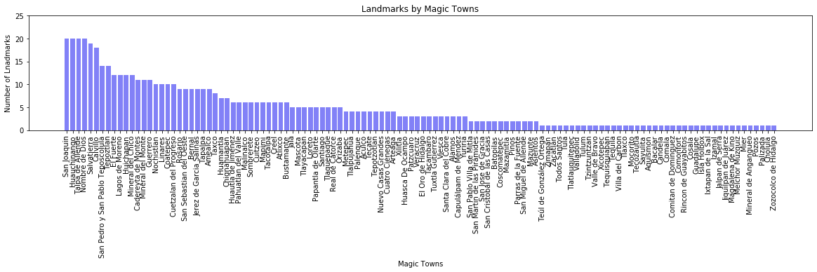
Which towns offer enough interest points that make visiting worthwhile?
Analysis
Best Magic Towns: San Joaquín, Huachinango, Talpa de Allende, Nombre de Dios
Worst Magic Towns: Zozocolco de Hidalgo, Cholula, Palizada, Pozoz,

Slide 21
9.-Acknowledge limitations
Findings and implications
Limitations
Technical: Api performance showed deficiencies (ie. concurrency problem)
Assumptions used in correlation analysis: The metric “the number of hotels in town” is limited as a proxy of the level of touristic activity by the the fact that:
Some towns are just one day visiting worthwhile (no more to see than 1 landmark, usually city center) or close enough to major cities.
Further analysis
A more exhaustive data cleaning could be filter accommodation options to those actually in town since, by default, Hoteles Api provide nearby Hotels even when they are not in the same locality
Analyse outliers to find out why they developed a big amount of accommodation types and good quality
Analysis in different time periods could provide insights about seasonality in each Magic Town
Landmarks categorization to analyze town attractiveness

Slide 22
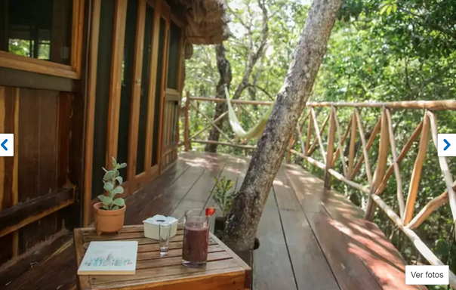
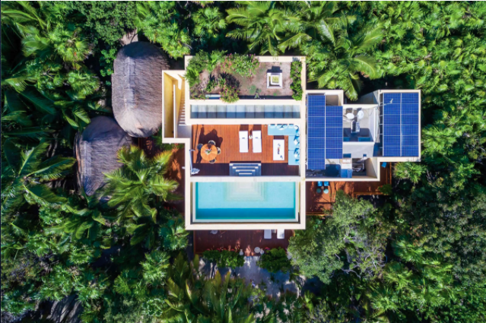
Findings and implications
Findings
Long way to digital economy...
Data not found in APIs:
Jalpa de Canovas couldn’t be found as a city
For hotel per town analysis, 25 Magic Towns have no results.
For airport analysis, 70 Magic Towns have no nearby airports
For prices analysis, only around 1,500 hotels have prices.
Most Magic Towns are clustered in the country center part of Mexico
Our outliers in the number of magic towns can be seen as successful ones due to accomodation quantity and quality
Star rating is not necessarily related to price. The new tendencies, as hotel boutiques or treehouse hotels, are changing the way in which customer are willing to pay.
Ajal Tulum Tree House (3.5 stars), Tulum, Tulum, Quintana Roo, México
Hacienda Chekul (3.5 stars) $71,845 MXN/night 2 adults

Slide 23
Thanks!

